Slide 1



Made in Danube
Transnational Cooperation to
transform knowledge into
Marketable products and services for the
Danubian sustainable society of tomorrow
Bioeconomy
Agriculture - Forestry - Bioenergy
Project co-funded by European Union funds (ERDF, IPA)
www.interreg-danube.eu/made-in-danube

Slide 2

Made in Danube - Objectiv
The aim of the project is to improve the framework conditions for innovation by supporting the collaboration process between companies and RTO in the innovation-driven field of bioeconomy.
The project main result is to intensify the cooperation of project partners with target groups (key actors) in the Programme Area leading to 15 innovation partnerships and 40 entreprises (SMEs) cooperating with research and technological organizations (RTO).
Project co-funded by European Union funds (ERDF, IPA)
www.interreg-danube.eu/made-in-danube

Slide 3
Specific Objectives
Developing a “Common Strategy to transform ideas into marketable products and services for the 3 existing regional Initiatives”
  Pilot implementation of the Local Action Plan for Smart and Innovative Precision Farming, SUA Slovakia ,
  Pilot implementation of the Local Action Plan for Competence Centre - Wood Sector, Croatia
  Pilot implementation of the Local Action Plan for Biofuel, UNS Serbia
Developing tools and services (Innovation Audits, Technology Offers/Technology Request, Brokerage Events, Training Tool KIT) to implement concrete transnational collaboration projects based on the needs of the 3 regional initiatives representative for the DR. They will allow to identify needs of companies involved and permit access to knowledge not locally/nationally available but in the transnational "Made in Danube" consortium of 10 countries in order to achieve East-West cross-fertilization.
Support good practices exchange in technology transfer and innovation partnerships by establishing a transnational network
Project co-funded by European Union funds (ERDF, IPA)
www.interreg-danube.eu/made-in-danube

Slide 4
Made in Danube
Germany
Kiev
Ukraine
SEZ
Stuttgart
Czech Republic
DTC
Nitra
Slovakia
Chisinau
Moldova
DTC
Cluj-Napoca
Vienna
Hungary
Austria
Romania
DTC
Pannon
DTC Maribor
Croatia
14 Partners,
3 ASP,
10 Countries
Slovenia
DTC
Bucharest
DTC
Vukovar
Bosnia-Herzegovina
DTC
Novi Sad
Serbia
DTC
Russe
Montenegro
Bulgaria
Germany
Austria
Slovenia
Slovakia
Croatia
Hungary
Serbia
Romania
Moldova
Ukraine
Project co-funded by European Union funds (ERDF, IPA)
www.interreg-danube.eu/made-in-danube

Slide 5
Made in Danube
Quadruple Helix Approach
Ministry of Economic Affairs - labour and Housing Baden-Württemberg, , GERMANY - ASP
Public authorities
National Authority for Science Research and Innovation, ROMANIA
Vinkovci Development Agency, CROATIA
Steinbeis-Europa-Zentrum, GERMANY
Institut of Market Problems and Economic Ecological Research of NASU – UKRAINE - ASP
Organization for Small and Medium Entreprise Sector
Development, MOLDOVA - ASP
R&D
Civil society
Industry, Facilitators
University of Natural Resources & Life Sciences, AUSTRIA
The Union of Slovak Cluster , SLOVAKIA
Technical University Cluj-Napoca, ROMANIA
Danube Chambers of Commerce Association, HUNGARY
Slovak University of Agriculture, SLOVAKIA
Pannon Business Network Association, HUNGARY
University of Maribor, SLOVENIA
Vinkovci Development Agency, CROATIA
Bay Zoltán, HUNGARY
BW Industry Association, GERMANY
University of Novi Sad Faculty of Technical Science , SERBIA
IPA Business Incubator, ROMANIA
Center for Social Innovation , AUSTRIA
14 Partners, 3 ASP, 10 countries
Project co-funded by European Union funds (ERDF, IPA)
www.interreg-danube.eu/made-in-danube

Slide 6
Benefits for Stakeholders
Could present the own expertise
Could create partnerships
Could have a common methodology and tools for TO Technology Offers, TR Technology Request, Innovation Audit
Could participate at the elaboration of a “Common Strategy to transform ideas into marketable products and services for the 3 existing regional Initiatives”
  Innovative Precision Farming, Slovakia ,
  Competence Centre - Wood Sector, Croatia
  Biofuel, Serbia
Could participate at Innovation audits, Brokerage Events, Trainings.
Could support good practices exchange in technology transfer and innovation partnerships
Could participate at “Made in Danube” transnational network
Could benefit from the Newsletters and could send imputs.
Project co-funded by European Union funds (ERDF, IPA)
www.interreg-danube.eu/made-in-danube

Slide 7
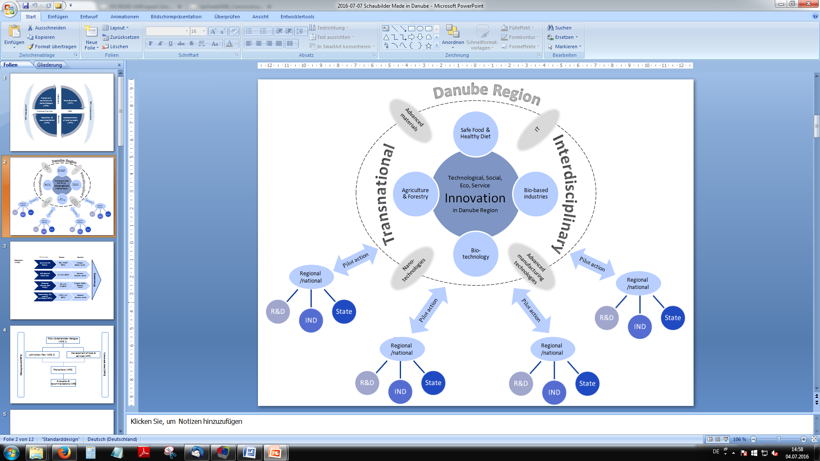
Made in Danube
“Missing links” at local level - Network of Networks
Project co-funded by European Union funds (ERDF, IPA)
www.interreg-danube.eu/made-in-danube

Slide 8
Made in Danube
WP 2 Communication
Implementation of pilot projects (WP5)
Policy Dialog (T3.2)
Framework conditions analysis – Roadmap
(T3.1)
Developing a Strategy (T3.3)
Evaluation and recommendations (WP6) Report for improvement of framework conditions
Tools and services (WP4)
WP 1 Management
Framework conditions and Policy Dialog
(WP3)
Implementation of pilot projects (WP5)
Evaluation and recommendations (WP6)
Tools and services (WP4)
Project co-funded by European Union funds (ERDF, IPA)
www.interreg-danube.eu/made-in-danube

Slide 9

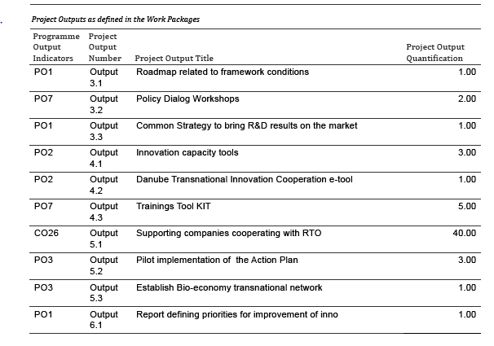




Made in Danube
Outputs & target groups
Regional
Public
Authorities
Civil Society
Business Support Organisation, Clusters and NGOs
Higher Education and Research Institutions
Project co-funded by European Union funds (ERDF, IPA)
www.interreg-danube.eu/made-in-danube

Slide 10











.
Projects synergy
Project co-funded by European Union funds (ERDF, IPA)
www.interreg-danube.eu/made-in-danube

Slide 11
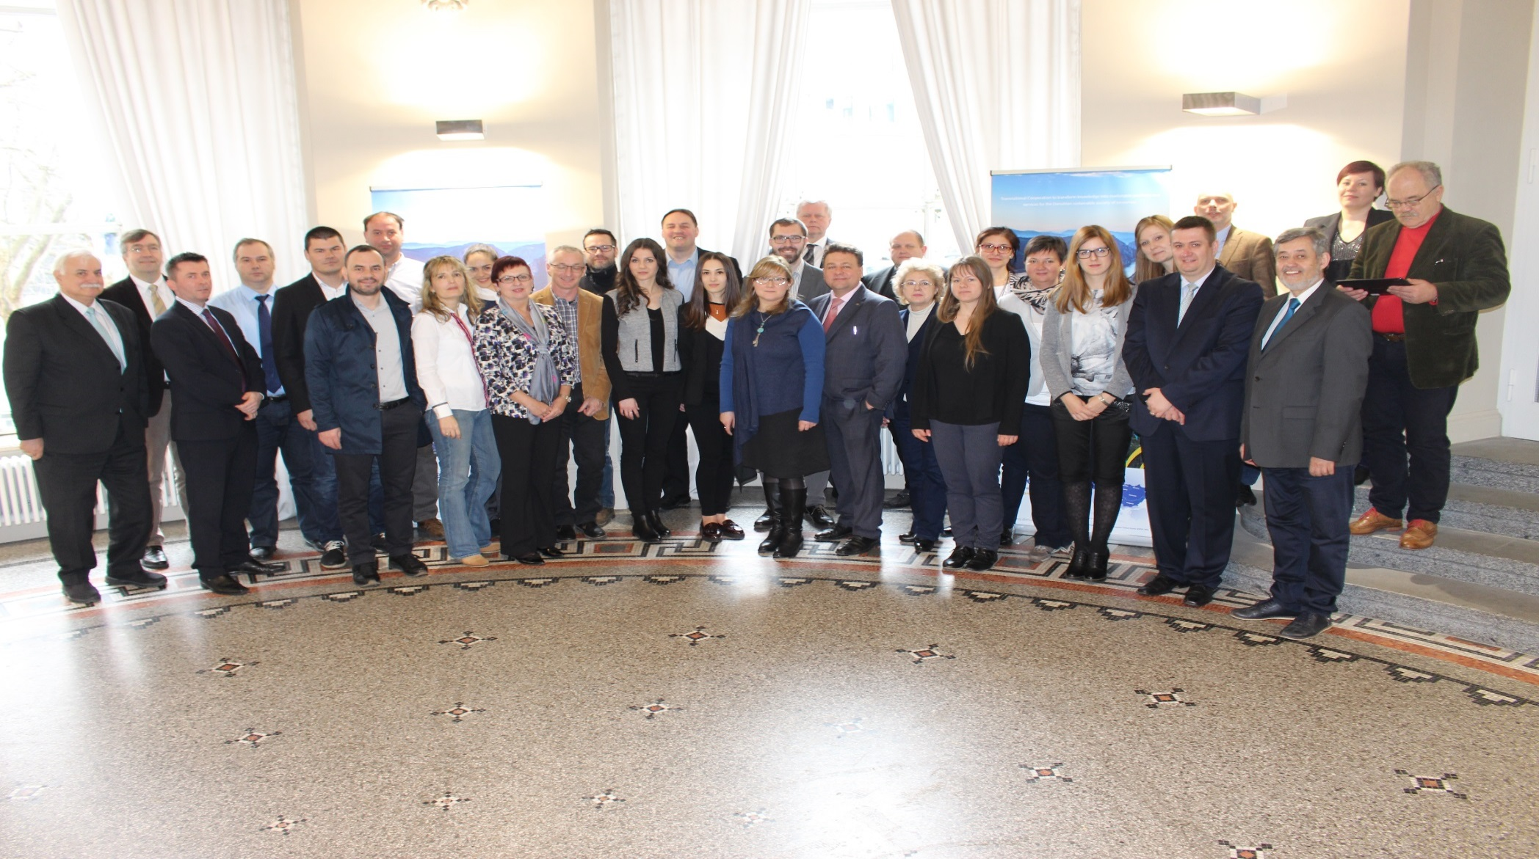
Made in Danube Team
www.interreg-danube.eu/approved-projects/made-in-danube
Project co-funded by European Union funds (ERDF, IPA)
www.interreg-danube.eu/made-in-danube

Slide 12
Made in Danube
Thank you for your kind attention!
Website http://www.interreg-danube.eu/made-in-danube
https://twitter.com/made_in_danube
https://www.facebook.com/Made-in-Danube
https://www.linkedin.com/in/made-in-danube
E-Mail: office@ipacv.ro
Tel: +40 251 412290
Fax: +40 251 418882
Project co-funded by European Union funds (ERDF, IPA)
www.interreg-danube.eu/made-in-danube

